Slide 1


General interview techniques
INTERNATIONAL AGENCY FOR RESEARCH ON CANCER LYON - FRANCE
e-SMP
Notes:
&&M: Advice: Pagenumber on the same spot every slide.

Slide 2

Purpose of the interview
Preparation, location & installing yourself
Opening the Interview
Conducting the Interview
Probing techniques
Closing the interview
Tips for getting better recalls
Attitude of the interviewer
General interview techniques
IARC, Lyon - France
GloboDiet training:

Slide 3


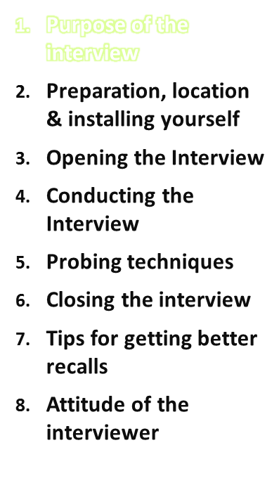
Explain purpose of the 24-hour recall to the respondent:
To get a complete list of all foods/drinks consumed by the respondent in a period of about 24 h of the recalled day
Specifically:
  What foods/drinks were consumed?
  How much of each was consumed?
  The times they were consumed?
  How were the foods/drinks prepared?
  How were they served?
  Specifics of food (low fat, 1%, whole)
General interview techniques
IARC, Lyon - France
GloboDiet training:

Slide 4
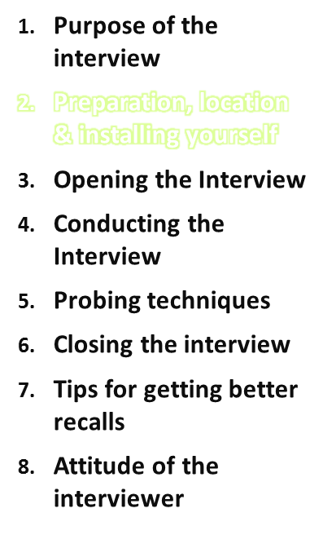
Prepare well for the 24-h recall interview & ensure to have all the necessary attributes (equipment/interview tools/materials)
Be accustomed to handling your tools, so that you don't find yourself fumbling and dropping things.
Make the physical environment comfortable
  Keep your desk neat
  Choose private & quiet location, away from distractions (e.g. ambulance noise, TV, radio)
General interview techniques
IARC, Lyon - France
GloboDiet training:

Slide 5
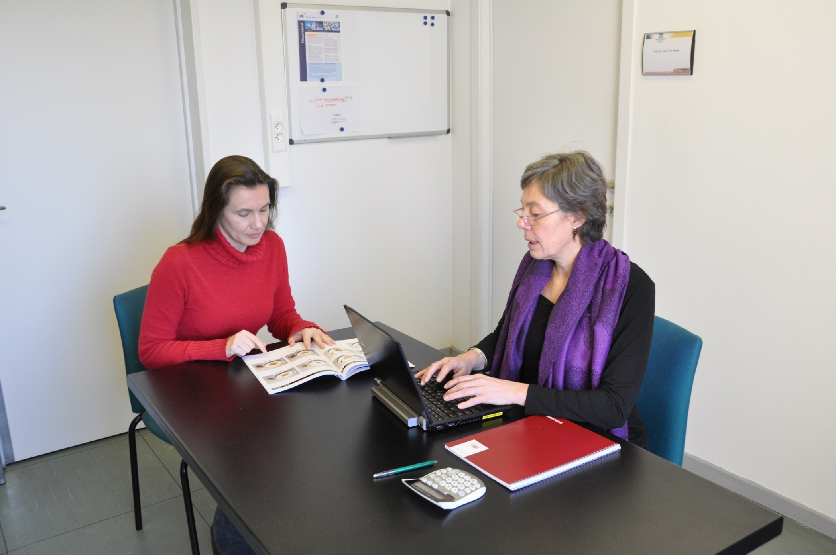
General interview techniques
IARC, Lyon - France
GloboDiet training:
Notes:
This picture shows a good work environment for conducting a 24-h recall interview

Slide 6
Place/location of the interview
The location of the interview may influence the subjects ability and willingness to report his/her diet.
Whenever possible, secure:
  a quiet room
  relaxed atmosphere
  no distractions from friends/relatives or others passing by
  reading materials available in the waiting room (study centre)
If there is somebody with the respondent, ask them tactfully to leave the room explaining why (privacy is important).
The success of your interview depends upon the privacy given and your ability to reassure the respondent that all the information he/she gives will be held in professional confidence.
General interview techniques
IARC, Lyon - France
GloboDiet training:

Slide 7
How to install yourself?
Have a table large enough for the: PC & picture book
Picture book, bread shapes, etc. should be placed so that they are easily visible/accessible for the subject.
Sit at an angle of about 90° from the respondent, if possible (not side by side).
BUT: Every person has a different comfort zone!
BUT: if logistically too difficult, the respondent can sit in front of the interviewer but NEVER next to the interviewer!
Always take the technical user manual and this practical guide with you, & any other helpful material (e.g. a paper with all the function keys of the program printed on it).
General interview techniques
IARC, Lyon - France
GloboDiet training:
Notes:
Sit at an angle of about 90° from the respondent, if possible (not side by side).
This will help you look at the respondent and prevent the subject from being distracted by the computer. Most subjects have no idea of their food quantities in grams. If they see these quantities on the screen, they may seem very large or small for them which may change their attitude/responses for the rest of the interview.

Slide 8



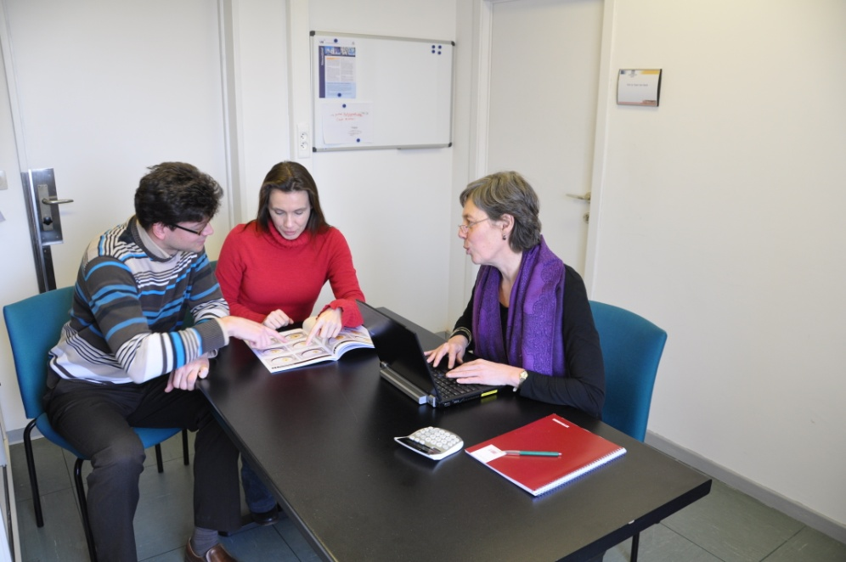
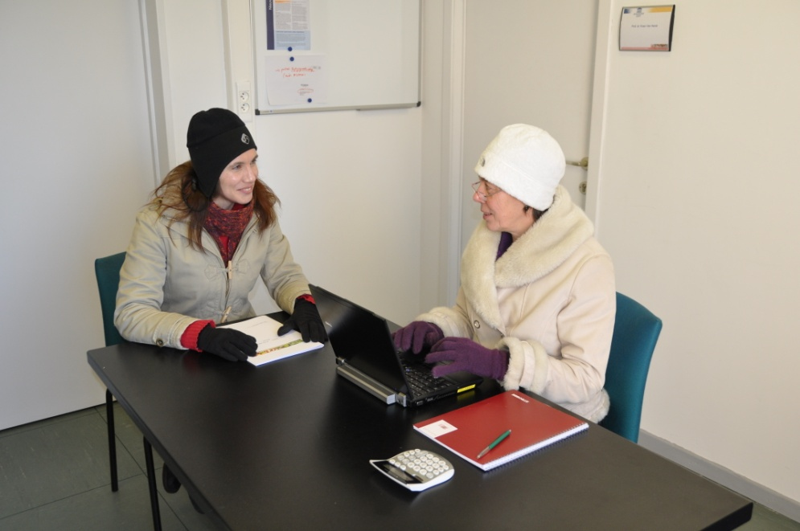
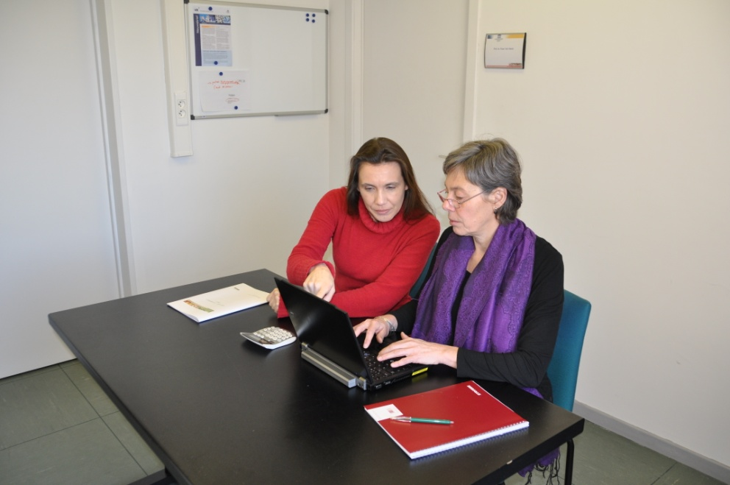
General interview techniques
IARC, Lyon - France
GloboDiet training:
Notes:
Picture 1: good practise
Picture 2: privacy is important, so the partner should be asked to leave and should definitely not interrupt the interview
Picture 3: make sure the climate in the environment is good (not too cold, not too hot …)
Picture 4: the respondent should not be able to watch the computer screen

Slide 9
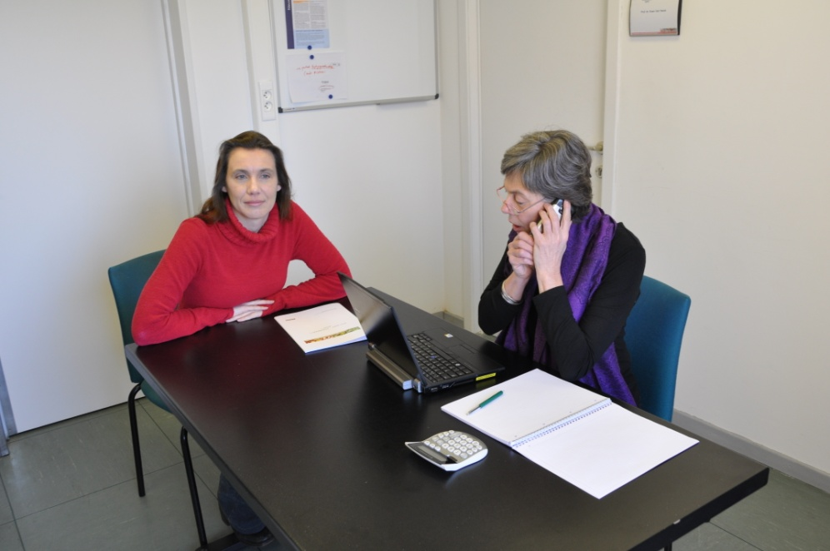
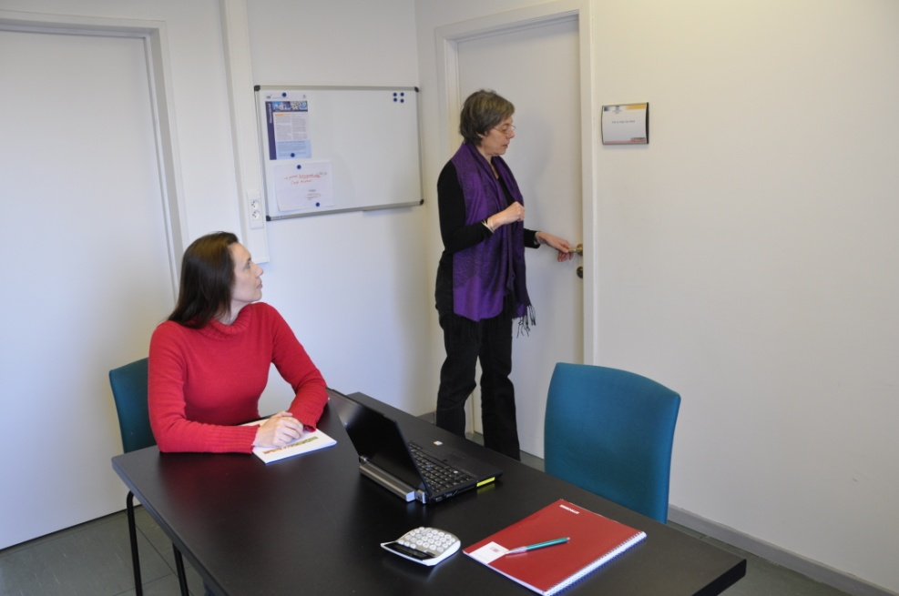
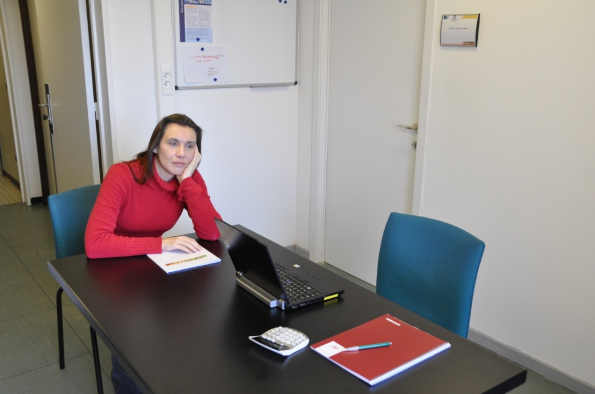

General interview techniques
IARC, Lyon - France
GloboDiet training:
Notes:
Picture 1: good practise
Picture 2: the interviewer should not interrupt the interview with a telephone call (interviewer and respondent should both switch off their mobile)
Picture 3 & Picture 4: the respondent should not be left alone for too long

Slide 10
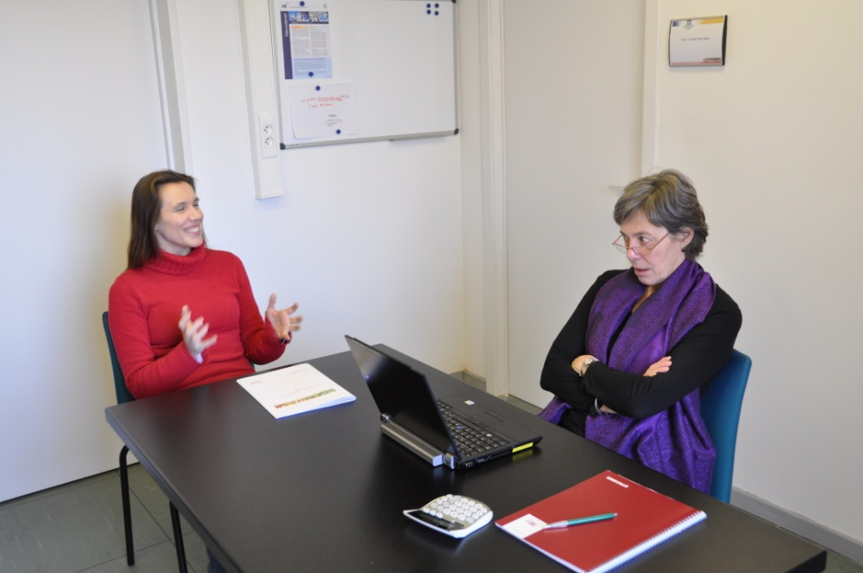
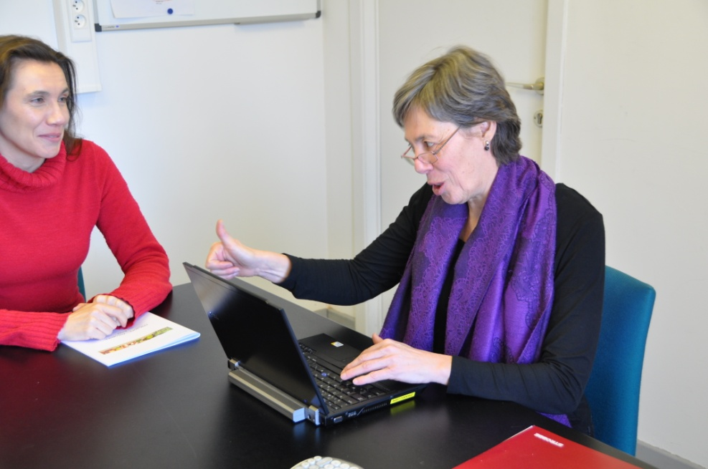
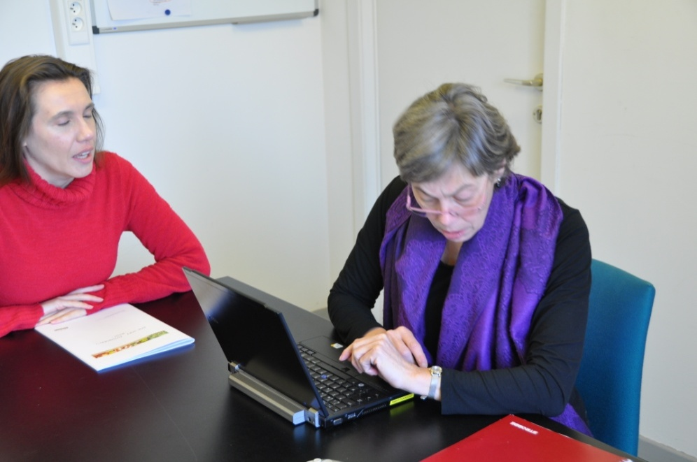
General interview techniques
IARC, Lyon - France
GloboDiet training:
Notes:
Picture 1: good practise
Picture 2: don’t make any judgements and be aware that also body language should be neutral
Picture 3: don’t make any judgements and be aware that also body language should be neutral
Picture 4: take your time for the interview and listen to the respondent even if he/she has lots of details to tell. Don’t watch your watch during the interview

Slide 11
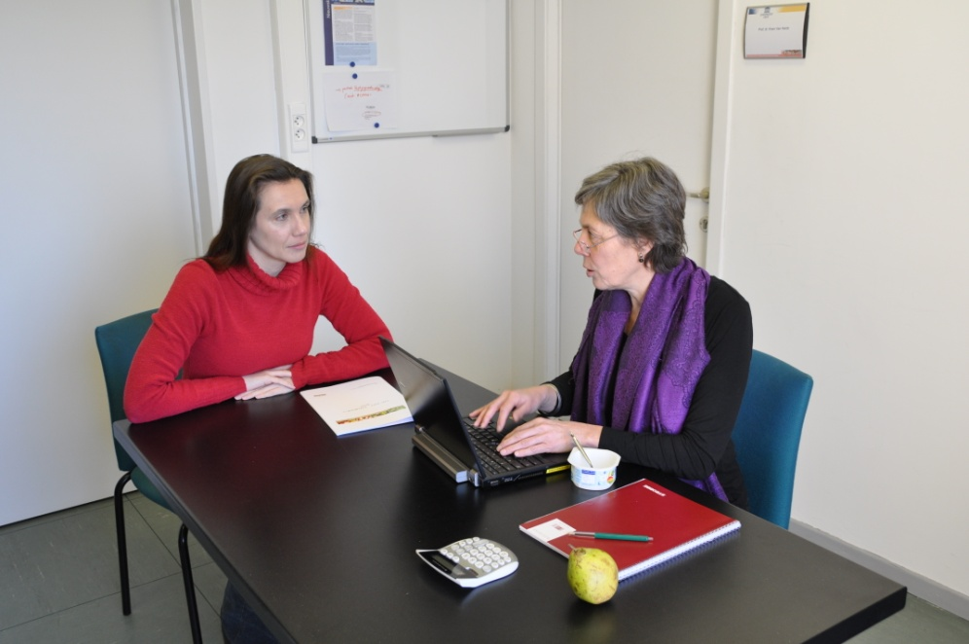
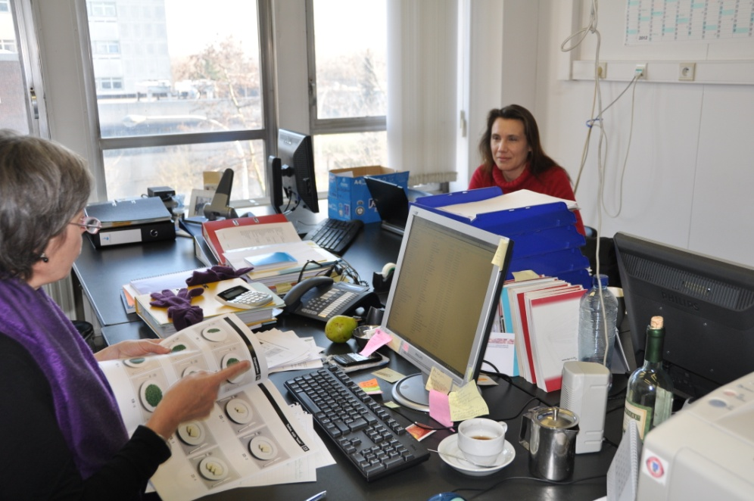
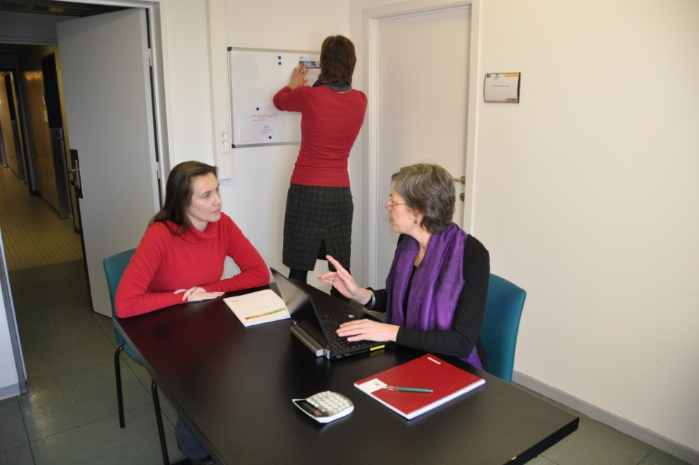
General interview techniques
IARC, Lyon - France
GloboDiet training:
Notes:
Picture 1: good practise
Picture 2: don’t eat during the interview
Picture 3: make sure that your desk is clean and organized and that the respondent is not sitting too far away
Picture 4: Privacy is important! Make sure that nobody enters the interview room during the 24-h recall

Slide 12
How to install yourself?
If the conditions (e.g. at respondent home) do not allow to install yourself according to the instructions given on the previous slides, then the interviewer can be more flexible, though should always respect the following:
  Sit never next to the respondent
  Respect the respondent’s comfort zone (you can check with the respondent whether she/he feels comfortable)
  Try everything to reassure as much privacy as possible even if the optimal situation (without any third person in neighbourhood) is not possible
  Stay always patient, polite and respectful!
General interview techniques
IARC, Lyon - France
GloboDiet training:

Slide 13
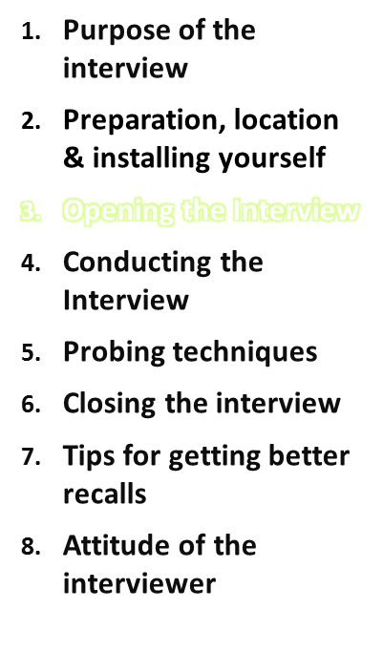
Try to build a professional yet comfortable (sympathetic, trusting, & friendly) relationship:
  Ask the respondent what he/she would like to be called
  Address the respondent by that name & the appropriate title (e.g. Mr./Ms, Dr.), for children: use the first name
  Introduce yourself
  Small talk: e.g. complement him/her for being on time
  Encourage the respondents to express themselves freely/ask any questions
General interview techniques
IARC, Lyon - France
GloboDiet training:

Slide 14
Opening the interview
Let respondent know you will do a 24-h recall, explain:
  What it is
  Discuss the purpose of what you will do with their info.
  How long it will take
    Allocate 1 hr., even though the interview should take about 30 min
  Privacy & confidentiality
    Reassure them that only the permitted staff will see respondent info, on a need to know basis to perform assessment
General interview techniques
IARC, Lyon - France
GloboDiet training:

Slide 15
Opening the interview
Help the respondent feel comfortable to encourage honesty
  “Don’t be embarrassed to share what you ate – there are no “good” or “bad” foods and no one eats the right foods all the time.”
  Be aware that this single 24-recall does not allow us to evaluate your usual dietary habits, so no judgments will be made.
It can be hard to remember everything eaten in the last 24 hours, allow for questions & comments.
Underline that all food items are important (even water)
General interview techniques
IARC, Lyon - France
GloboDiet training:

Slide 16
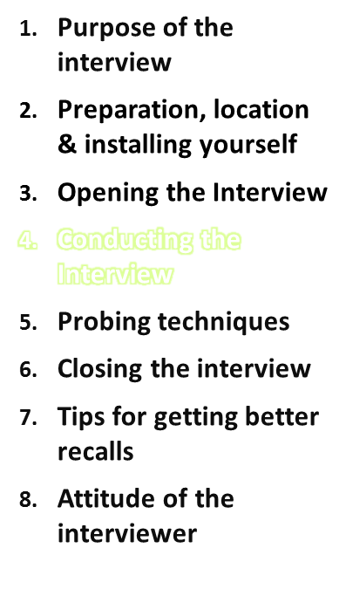
Ideally the 24-h recall interview should be conducted via a stepwise procedure that:
  Starts with a brief overview of all foods and drinks consumed the day before
  Only in a second step the detailed description of the foods and drinks consumed should be collected
  See 3 Step method under ‘specific GloboDiet interview techniques’
General interview techniques
IARC, Lyon - France
GloboDiet training:

Slide 17
Three different types of questions
Open or neutral questions - require a narrative or explanatory response; allows the respondent to talk about information that he/she feels is important.
    Start with what, how or when or an open statement.
    “What is the first thing you had (to eat or drink) in the morning?”
Closed Ended questions - require only a yes or no answer and provide no additional information. Can be used to ask for specific information but fail to reveal anything else about the respondent’s attitude. Start with did you …
    “Did you add salt to your food at the table?”
    “Did you take any dietary supplements?”
Leading questions - interviewer makes suggestions about the desired or expected answer
    “You don’t drink whole milk, do you?”
    What do you eat for breakfast?”
General interview techniques
IARC, Lyon - France
GloboDiet training:

Slide 18
Conducting the interview
Begin by asking open ended questions
Save close ended questions for later
Avoid leading questions (“You don’t drink whole milk, do you?”), that would lead respondent to feel she/he “should” have had a certain item and thus say she/he did.
Be familiar with local dietary habits (synonyms, canteen practices…)
Don’t be influenced by interviewee’s behaviour or your own dietary habits
Be neutral: do not express judgement, nor give advice
General interview techniques
IARC, Lyon - France
GloboDiet training:

Slide 19
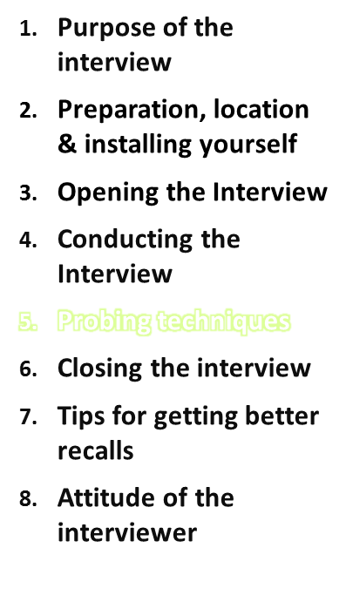
What is probing ?
Probing is a technique used by the interviewers to obtain more information, used especially when the respondent's answer is not meaningful or complete. Probing has two major functions:
  To motivate respondents to elaborate, clarify, or explain their answers
  To focus the respondent’s answer so that irrelevant and unnecessary information can be avoided.
It is very important that probing should be done very carefully without introducing bias or annoying the respondent.
For standardization, all the interviewers should use the probings in a similar way.
General interview techniques
IARC, Lyon - France
GloboDiet training:

Slide 20
Probing techniques
Be neutral in your "probes"
  Foods to probe for automatically appear on the screen after description and quantification of the food they may belong to.
  Formulate the questions around these foods as neutral as possible.
  Instead of asking if the respondent had butter, jam etc. on his bread you better ask if he/she had anything on his bread.
  You should not imply the answer in your question, which may make the respondent feel that these are 'normal' combinations.
  General probing may be related to meal structure. E.g. ask if the subject drank anything with his meal.
  Another way of probing is to repeat the information provided and ask if anything is missing.
When to stop "probing" ?
  As soon as you have obtained the maximum of information
  when the subject becomes irritated or annoyed.
General interview techniques
IARC, Lyon - France
GloboDiet training:

Slide 21

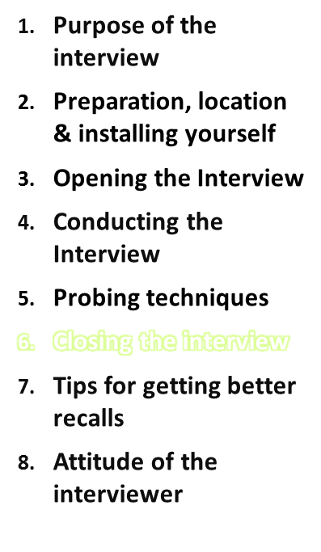

Outline
Thank the respondent for his/her patience & cooperation.
Inform the respondent on the next steps.
Ask the respondent whether he/she has any remaining questions related to the survey or interview.
No personal feedback should be given about the 24-h recall!!! Personal feedback could bias the next 24-h recalls.
Say to respondent that only 1 recall is insufficient to give any feedback.
General interview techniques
IARC, Lyon - France
GloboDiet training:

Slide 22
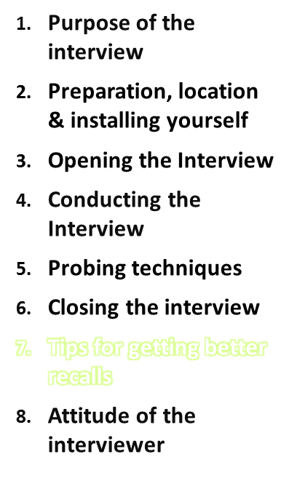
Six Tips
Be attentive
Respect and reassure respondent about privacy
Take notes
Interpret “don’t know answers” carefully
Be sure to ask about details & mixed dishes
If the kind of food is unclear → ask for description
General interview techniques
IARC, Lyon - France
GloboDiet training:

Slide 23
Tip 1 Be Attentive
Look at the interviewee when she/he speaks.
Nod or say “ahummm” to show that you are listening.
Ask detailed questions when interviewing.
Non-verbal behaviour shows your attentiveness, too!
General interview techniques
IARC, Lyon - France
GloboDiet training:

Slide 24
Tip 2 Respect privacy
Do not share information about others’ diets if not appropriate.
Let the respondent know that you respect his/her privacy and will keep things between the two of you.
Hold the interview where the respondent feels that he/she has enough privacy.
General interview techniques
IARC, Lyon - France
GloboDiet training:

Slide 25
Tip 3 Take Notes
Take notes to help you remember what was said and to help you discuss with the respondent what was eaten.
Take notes to add any extra information that could be relevant for the data cleaning procedures
General interview techniques
IARC, Lyon - France
GloboDiet training:

Slide 26
Tip 4 I Don't know ?
The "I don't know" or "I don't remember" answer can mean several things:
  Doesn’t know or remember,
  Is thinking the question over (fills the time needed to think with this answer)
  Doesn’t understand the question (says "don't know" to avoid saying “don’t understand”)
  Evades the issue (feels afraid of giving the wrong answer)
  Try to figure out the reason and give the subject time to think the question over. Sometimes probing may help to remind them of events, situations and surroundings they were in, subsequently recalling the foods.
General interview techniques
IARC, Lyon - France
GloboDiet training:

Slide 27
Tip 5 Ask about details & mixed Dishes
You can request to see the recipe (e.g. in cook book) if available (when interview conducted at home)
You can request to see the packaging to take notes on ingredients and nutritional values while entering the brand name by the facet
If the interview takes place in a study center, you could ask the respondent to send/give you this packaging material later on
General interview techniques
IARC, Lyon - France
GloboDiet training:

Slide 28
Tip 6 When kind of food is unclear
If the respondent tells you that he/she ate a certain product, but does not know the name of the food, or its ingredients, ask to describe the food and its:
    size,
    shape,
    taste,
    etc.
If you cannot guess the product, write all the descriptors in the notes screen and find out later.
General interview techniques
IARC, Lyon - France
GloboDiet training:

Slide 29
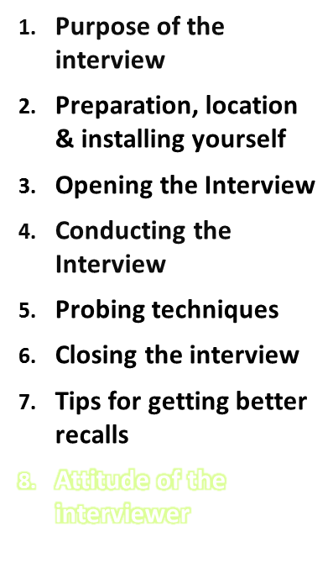
Introduce yourself
Check your appearance
Behave inconspicuous/discrete
Always remain neutral
Get the participants actively involved
Discourage unrelated conversation
Answer respondent's questions
Get the interview to your speed
Do not rush through the interview
Comfort the respondent when he/she is nervous
Manage sensitive subject matter
General interview techniques
IARC, Lyon - France
GloboDiet training:

Slide 30
Attitude of the interviewer
Introduce yourself
  Introduce yourself, and explain that the interview will remain confidential.
Check your appearance
  In general, the objective is to be neat and discrete. Dressing extremes of any kind should be avoided.
Behave inconspicuous/discrete
  Unprofessional activities, like smoking or chewing gum should be totally avoided while conducting the interview.
General interview techniques
IARC, Lyon - France
GloboDiet training:

Slide 31
Attitude of the interviewer
Always remain neutral
  During the entire interview you must always maintain a neutral attitude.
  You must never allow anything in the tone of your voice, words or manner to express/suggest criticism, surprise, approval/disapproval of the questions you/they ask or the answers given.
  Never show to be surprised about any unusual foods or unusual portions.
General interview techniques
IARC, Lyon - France
GloboDiet training:

Slide 32
Attitude of the interviewer
Always remain neutral
  No matter how strongly you agree or disagree with the answers, now matter how interesting, unusual or discouraging you find those answers to be, you must always maintain the same neutral and professional manner during the interview.
  Stay neutral if the subject asks you to judge the food he/she consumed.
  You are there to record the respondent’s answers, not to influence or give advice in any way.
General interview techniques
IARC, Lyon - France
GloboDiet training:

Slide 33
Attitude of the interviewer
Get the participants actively involved
  An important part of your interviewer role is to get the respondent actively involved in the interview, to lead him/her to talk comfortably and freely in response to your questions.
  While encouraging, avoid saying or doing things that may influence the respondent's answers.
General interview techniques
IARC, Lyon - France
GloboDiet training:

Slide 34
Attitude of the interviewer
Discourage unrelated conversation
  A question may lead a respondent to tell a lengthy story having little or no relevance to the survey. As an interviewer, your task is to discourage such irrelevant conversation and keep the discussion focused on the interview. If you must interrupt a respondent, do it politely, taking care not to antagonize him/her.
  However, if the respondent has a question related to the interview itself, then please allow the respondent to ask those questions and answer him/her politely (see next slide).
General interview techniques
IARC, Lyon - France
GloboDiet training:

Slide 35
Attitude of the interviewer
Answer respondent's questions
  Be always ready to answer respondent’s questions if they come up. Listen to the respondent and answer only what is asked. Unasked information may be boring or misunderstood. With the information given during the training course you can prepare your answers on questions about the study.
Get the interview to your speed
  Sometimes the respondent may speak more quickly than you can type or go through the software program. Repeat what you typed in order to check with the subject that you correctly recorded everything.
General interview techniques
IARC, Lyon - France
GloboDiet training:

Slide 36
Attitude of the interviewer
Do not rush through the interview
  It is important to allow the subject sufficient time to consider their answers. If pressed to answer too quickly, they may react by inventing answers or saying that they cannot remember.
  Try to maintain the same speed during the interview. To control the time, use the watch function on your screen instead of looking at your watch.
Comfort the respondent when he/she is nervous
  If you detect hesitancy or nervousness on the part of the respondent, it is important that you take the time to stress the confidential nature of the interview and the professional relationship you have.
General interview techniques
IARC, Lyon - France
GloboDiet training:

Slide 37
Attitude of the interviewer
Manage sensitive subject matter during the interview
  Each interview you conduct during the course of the study will be an unique and delicate transaction between you and the respondent.
  The questions asked might possibly be perceived as sensitive by the respondent. If you feel uncomfortable or nervous about asking any of the questions, try to overcome this because it may change the respondent’s answers.
  Be neutral and serious!
General interview techniques
IARC, Lyon - France
GloboDiet training:

